Slide 1
CWYFL U12 &13’s - 2017/18

Slide 2
PLAYER REGISTRATIONS
For the 2017-18 season the league has chosen to use the Whole game player registration process.
With a new process, comes a need for extra guidance. We have therefore detailed the essential information below that we hope provides leagues and clubs with the support needed. Background Information and Benefits of WGS Player Registrations In 2016/17, The FA piloted the WGS Player Registration process in over 60 leagues across the country. Feedback and learning from these pilot leagues was gathered, after which improvements to the system were made in preparation for the national roll-out this season. The benefits of WGS Player Registrations are vast, but essentially it will ensure a more efficient, effective and joined up player registration process, which will save time for club and league volunteers in the future
Easier to track Discipline – (i.e. avoid De-Duplication of Players)
WGS will provide a live list of suspended players
Linking Player Information on WGS and Full-Time – avoiding repetition and duplication of processes
Efficiency of the Registration Process
Consistent approach to registrations across the County
• People now familiar and expect efficient online processes – this process is a step in that direction

Slide 3
PLAYER REGISTRATIONS
Some the processes can vary slightly compared to previous . Therefore the below guidance will help your club understand some questions you may need to ask of your league registration officers; • Clubs will only need to complete “data-cleansing” once on the WGS. This will transfer players set up on full time over to the WGS.
• The leagues will require clubs to upload Player Photos on the WGS - This is a requirement for players in leagues from u7 – u18 football.
• Clubs responsibility to confirm Player ID checks on the WGS- This is a requirement for players in leagues providing u7 – u18 football.
• Consent – Online consent: by setting up the parent/guardian on the WGS, an email will be sent to them requesting approval. If your club is obtaining offline consent (i.e. a signed player registration form or contract with club) will be required.

Slide 4
PLAYER REGISTRATIONS
Assigning Club Officials To avoid a club secretary having to register every player in their club, it is advised that clubs assign player registration officers (Managers) within their club to input player details and register the players for the club. Clubs can assign several Player Registration Officers, and they can also remove the official(s) from this role at any point. How To Guide: click HERE.
Data Matching of Players This tool is available for leagues that currently use the FA Full Time website, you will simply be able to check that player details are correct before then selecting 'Match' to attach that player to your club. How To Guide: click HERE.
Search & Create Players To do this you will use the Data Cleansing Tab, this will bring up 3 Tabs: Suggested Matches – Players that are on Full Time and the Whole Game System, you will need to confirm that the details are correct before then matching the player/s.Unsuggested Matches – Players that are on Full Time, but cannot be found on the Whole Game System initially, you will need to search for the player/s on the Whole Game System and if you still cannot find the player you will then create a new player on the system. Completed Matches – All matched players, who will also be visible in the Player Registrations Tab. Please follow the below link for guidance on how to do this process. How To Guide: click HERE.

Slide 5
PLAYER REGISTRATIONS
Assign Players To Teams Once the player has been linked to the club and they appear under the Player Registrations Tab, you will then need to assign them to a specific team within your club. How To Guide: click HERE.
Detaching Players On your club's Whole Game System, you may still have players linked that are no longer at your club, we advise to view the current players linked with your club first and detach any that are no longer involved with the club. How To Guide: click HERE.

Slide 6
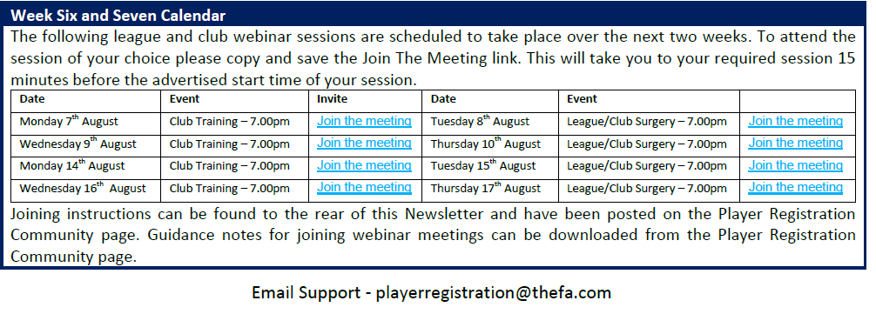
PLAYER REGISTRATIONS
Training Dates

Slide 7
PLAYER REGISTRATIONS
Player Registration FAQs
How do I get duplicated FAN records removed?
Please contact your County FA with details of the two FAN records for them to de-duplicate.
How do I correct Date of Birth/Gender/Name for individuals?
Please contact your County FA who will be able to update the details if these are incorrect (note that if the gender or date of birth has not been set, you can amend it)
What if a Team is not shown under a list of Club Teams?
Check with your County FA whether the team was affiliated – they may need to be added
What if a Team is shown with the wrong league (or no league)?
Check with your County FA whether the team has been assigned to the correct league, they can amend it if required
How do I add a Player Registration Officer to a Club?
You can add a Player Registration to a Club from the Club Officials page. Click on Add Official and use the options to find the person and give them the role of Club Player Registration Officer.
Does a Youth Player have to have a Parent provided?
No, for season 2017-18 we have made a change and a parent is optional for a player aged 16 or under, although if there is no parental record, Online Consent for the player will not be an option as this requires the parent to be able to login to the WGS Portal.

Slide 8
PLAYER REGISTRATIONS
Player Registration FAQs Continued
Do I need to provide email address and date of birth for Parents?
No, but if you wish them to login to WGS Portal to update their children’s details, or provide online consent, these need to be on the FAN record to be able to login to the WGS Portal, as they are needed to retrieve passwords
Do I need to provide a photograph for registration?
Yes, a clear image must be uploaded prior submission
Does a player need to have a FAN to be registered?
Yes, each player needs to be on Whole Game System, and a FAN (FA Number) will be automatically generated. This should then be their unique record for their football career
I have sent a consent request but the player is telling me that an email has not arrived?
The emails for consent are now sent within the hour (previously these had been sent overnight), and only if the player has not already acknowledged their notification requesting consent.
Please ask the player to check that their Spam/Junk folder as some email notifications are
incorrectly being directed into these folders.
Can a Photograph be updated for a registered player?
Once a player has been registered by a league, then the player’s photograph cannot be updated. However, if the registration has been approved without a photograph (i.e. the league has set the photograph as optional) then a club may still add a photograph after registration.

Slide 9
Friday 11th August 2017
Remember you must have 11 players registered by the above date (11-a-side)/ 9 players for (9-A side)
Additional registrations/transfers can be completed before and during the season until Wednesday 14th March 2018
Maximum squad size is 18 (11 v 11), 16 (9 V9)
De-register to register new players
Please note any registrations over 18 (11 v 11) or 16 (9V9) players is £5 per player,
Transfer’s are £5 per player.

Slide 10
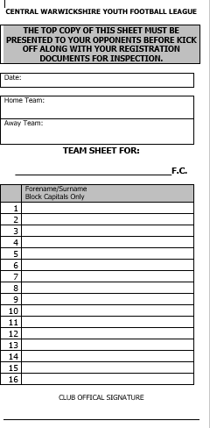
MATCH DAY FORMS
Match Day Forms are mandatory and are required to be completed on any given match day.
Hand over a completed match day form to the opposition mangers for them to cross reference the data to what will be inputted on full time. Any discrepancies, notify the league divisional.
Any team failing to follow this process will result in a fine, if the league have been notified.
In addition the CWYFL will carry out spot checks throughout the season and be handing out on the spot fines to any team not following these steps.
Match day forms can be found on:
U13: http://u13cwyfl.weebly.com/team-details--guides.html
U12: http://cwyfl12.weebly.com/information.html

Slide 11
Fixture Dates
Season will start on Sunday 10th September
The League Fixture Season will finish on Sun 22nd April apart from Cup games, or postponed games from April’s fixtures. We may schedule games for the 29th of April if required.
Double Headers will be implemented if mid-week games are required
No Fixtures 24th ,31st December and 1st April (Easter)
Please note Villa Blues are playing on: (Potentially) Sun 28th October & Sun 10th February, TBC.(Games will still be scheduled on these dates, so request a 21 day request if required).

Slide 12
21-Day Requests
You are allowed 2 per season.
These should be used to cancel a FIXTURE DATE you can’t play on
Fixtures will only be posted AFTER the 21-Day period has expired.
DON’T WAIT until you see a fixture to submit a 21 day notice, as you will be out of time.

Slide 13
KICK OFF TIMES/VENUES
Please supply kick off time to your divisional secretary before the season starts.
Kick Off time should be your STANDARD REGULAR time.
If you wish to change your VENUE or KICK OFF TIME for any particular week you are required to give your Divisional Secretary 8 DAYS notice.
Please make your secretary aware of any Ground share arrangements you have in place so we can arrange the fixtures accordingly.

Slide 14
CONFIRMING FIXTURES
All fixtures should be confirmed by the HOME side to both the AWAY SIDE and the REFEREE before WEDNESDAY 9.30PM
If the AWAY SIDE do not receive confirmation, please attempt to make contact with the HOME side and inform your divisional secretary.

Slide 15
RESULTS
Please report your results before 18:00 hours on the day of any given fixture.
This is a requirement for the HOME side.
Away team can report if results are missing on the website.
Submit your results by using the Full time SMS service

Slide 16
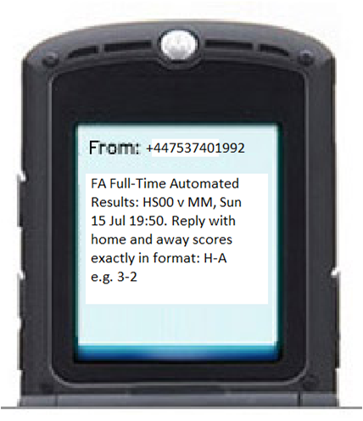
SMS SUBMISSION
You will receive the following text 15 minutes after your kick off time.

Slide 17
REPLY - SCORES
The reply should read as followed if the home team win Two- Nil: 2-0
The reply should read as followed if the Away team win Two- Nil: 0-2
The reply should read as followed if the game was a two-two draw: 2-2
If the game goes to extra time or penalties An example of a reply: 2-2 3-3 AET 7-6 pens
Postponed games - The reply should read: P-P
Please do not add any TEXT or extra numbers
Please note, if the results are showing incorrect on the full time system, reply again to the text you received, to overwrite the result.

Slide 18
ONLINE MATCH REPORT FORMS
Match reports are to be completed on FULLTIME within 4 days of the fixture. Failing to do so will result in a disciplinary notice being issued, which could result in a fine?
Login to the full time website and click on Results/Stats
Enter the fulltime score from the fixture, if you haven`t replied via the SMS facility
Enter the referee mark out of 100. Any score under 61 will require you to complete a referee report
Complete the respect campaign questions
Enter your players Stats & Save
Full user guide can be found here: http://u13cwyfl.weebly.com/team-details--guides.html

Slide 19
CUP COMPETITION’S
Open Cup – All teams
League Cup - Premier, Division One
League Trophy – Division Two, Three, Four
League Shield – Division Five, Six, Seven
All Semi-Final’s – Neutral Grounds
Finals Venue – To be announced

Slide 20
REFEREES
Referees are allocated by our referee secretary Kevin Carroll
All matters concerning Referees should be directed to Kevin via email.
Email: refereescwyfl@gmail.com
Website: http://www.referees.webeden.co.uk
Current Match Fees: U13 (£30) – U12 (£26)
Double Header match fee for 11v11 is £45 – 9V9 £39
Shared equally between both teams

Slide 21
TOURS
If you wish to take your team on tour, you must seek permission from the General League Secretary (Dave Arrowsmith), in writing before 31st December 2017.

Slide 22
Keep up to-date
U13 website: www.u13cwyfl.weebly.com/
U12 Website: http://cwyfl12.weebly.com/
League website: www.cwyfl.org.uk
facebook.com/CentralWarwickshireYouthFootballLeague
twitter.com/cwyfl

Slide 23
Summary: Manager Responsibilities
Home Team - Match Day | Away Team - Match Day
Contact opposing manager and referee prior the Wednesday 9:30 PM Provide a stand in referee if one has not been allocated Supply 2 match balls Complete Home Team match form Exchange ID’s Pay Referee immediately following the fixture (Birmingham County Cup fixtures - home team are solely responsible for payment) Collect completed Away Team match form Reply to FA Fulltime SMS with full time score Complete online match sheet, using the FA fulltime website within 4 days of the fixture (Thursday) | Complete Away Team match form Exchange player ID’s Pay 50% of referee’s fee to home team manager Hand the completed Away Team match form to the home team manager Collect completed Home Team match form Reply to FA Fulltime SMS with full time score (Optional) Complete online match sheet, using the FA fulltime website within 4 days of the fixture (Thursday)

Slide 24
Various?

Slide 25
Various?
Corner posts and flags are required.
Playing time is 35 minutes each way
If teams finish level on points, a Playoff Fixture will be arranged.
Semi-Final Fees – CWYFL no contribution
Age Group | Minimum duration of play per half (minutes) | Maximum duration of play per half (minutes) | Maximum playing time in one day in all organised development fixtures (minutes) | Maximum playing time in one day in all tournaments and trophy events / festivals (minutes)
Under 12 | 20 | 30 | 80 (if applicable) | 120
Under 13 | 25 | 35 | 100 | 150

Slide 26
Finally......
Each divisional secretary will give you there availability times as directed.
Enjoy the season
We are here to help
If possible, try to bring us the solution not just the PROBLEM

Slide 27
QUESTIONS

